Slide 1

Improving the hotel traveling experience
Group 7

Slide 2
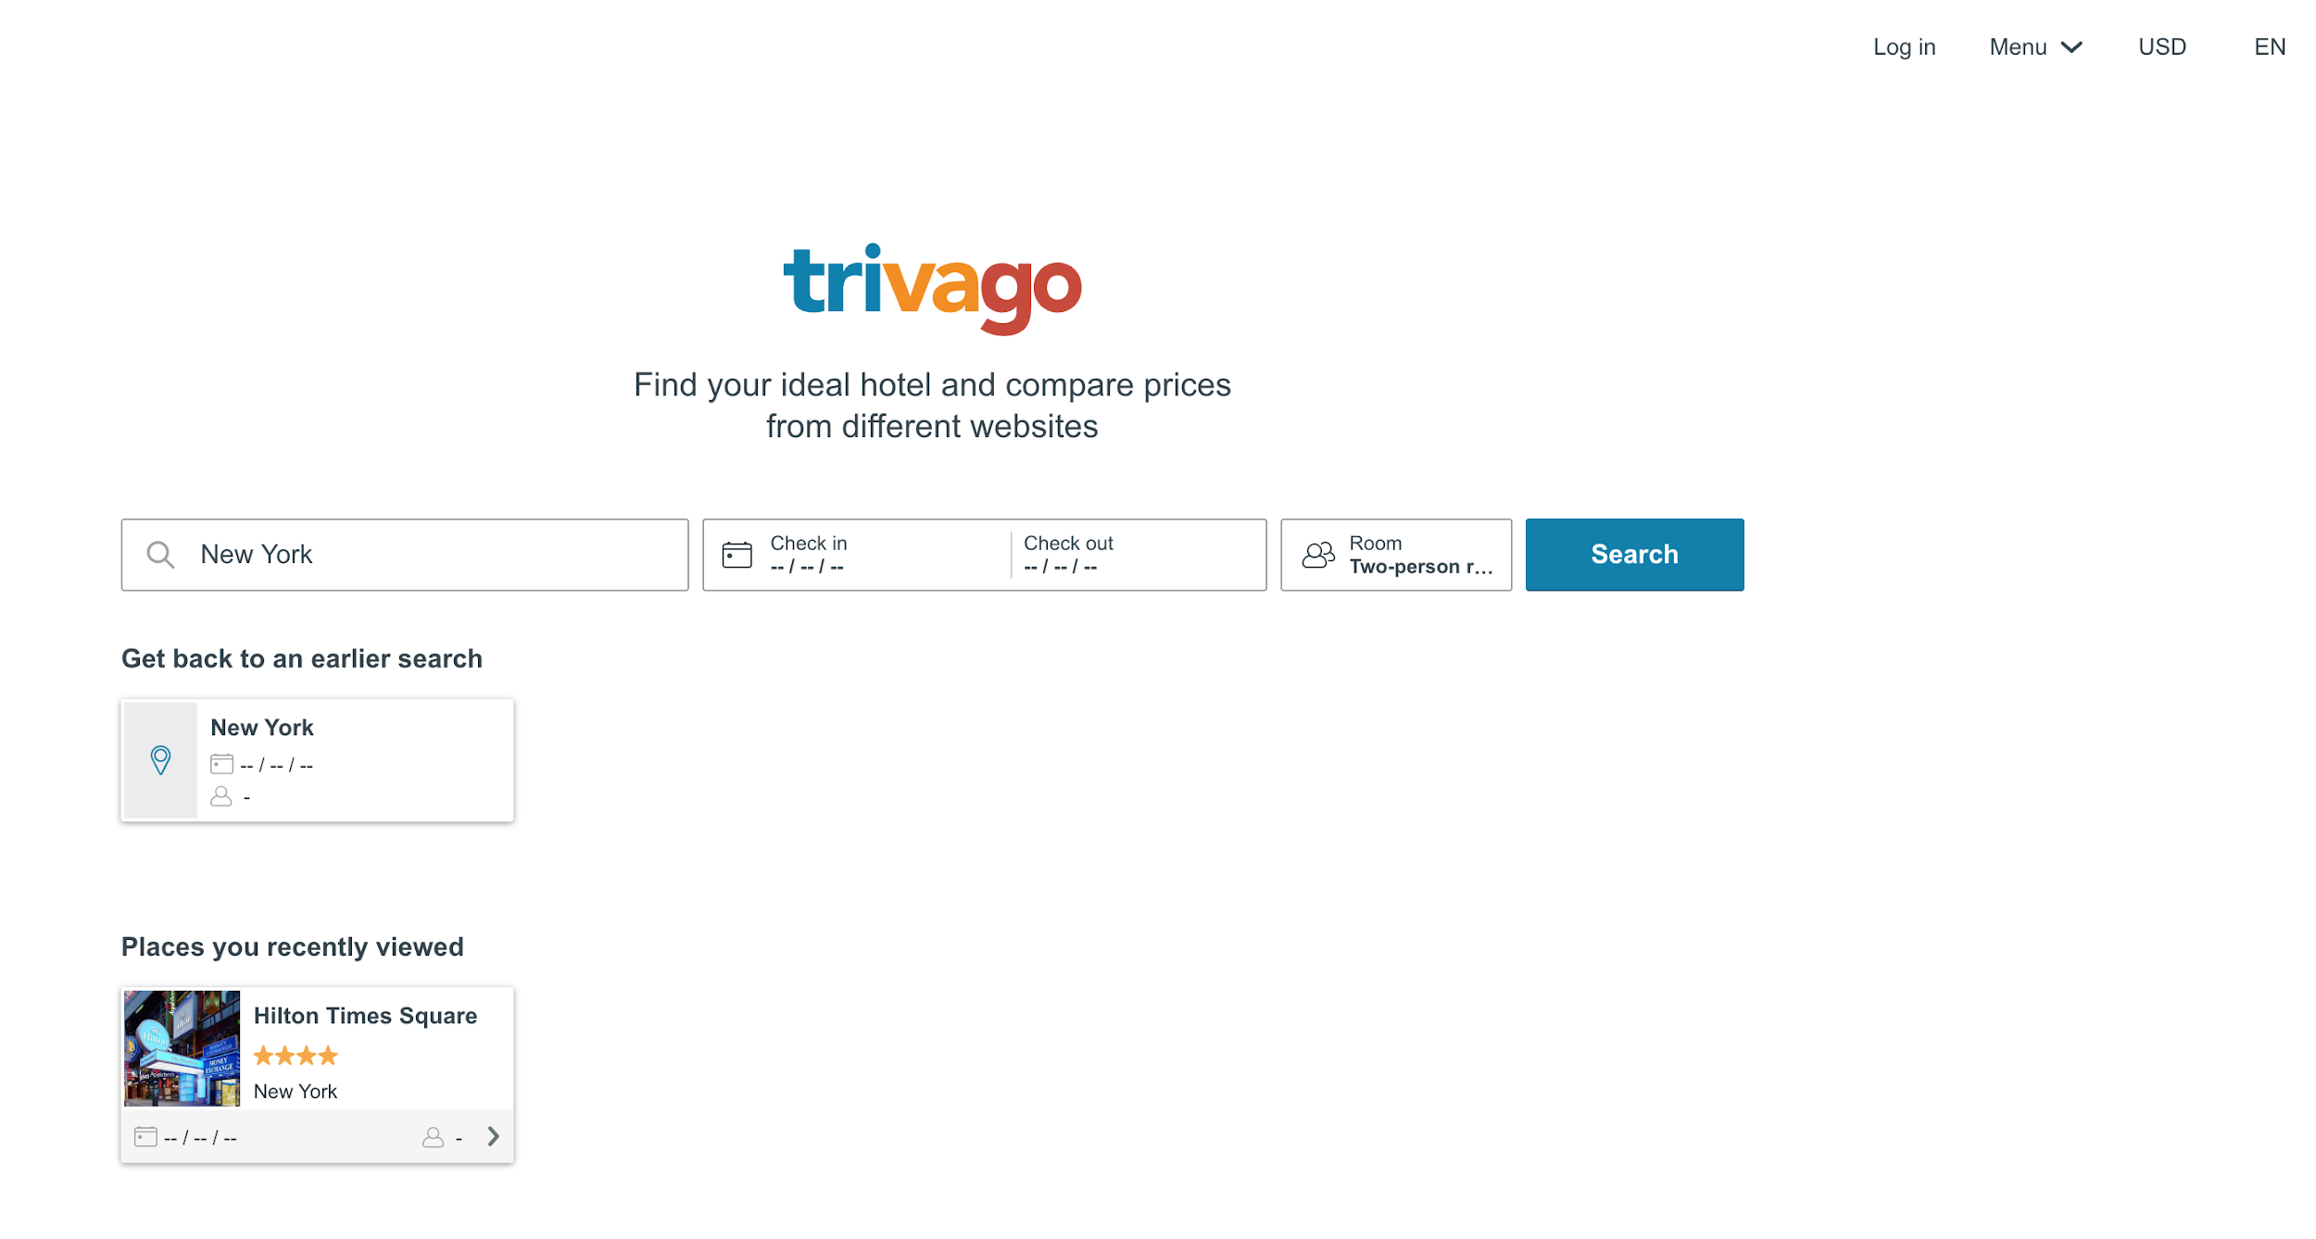
What is Trivago?
trivago is a German company specializing in services related to hotel, lodging, and meta search fields.
Users can search based on the best deals, location, rating, free breakfast, and other fields.

Slide 3
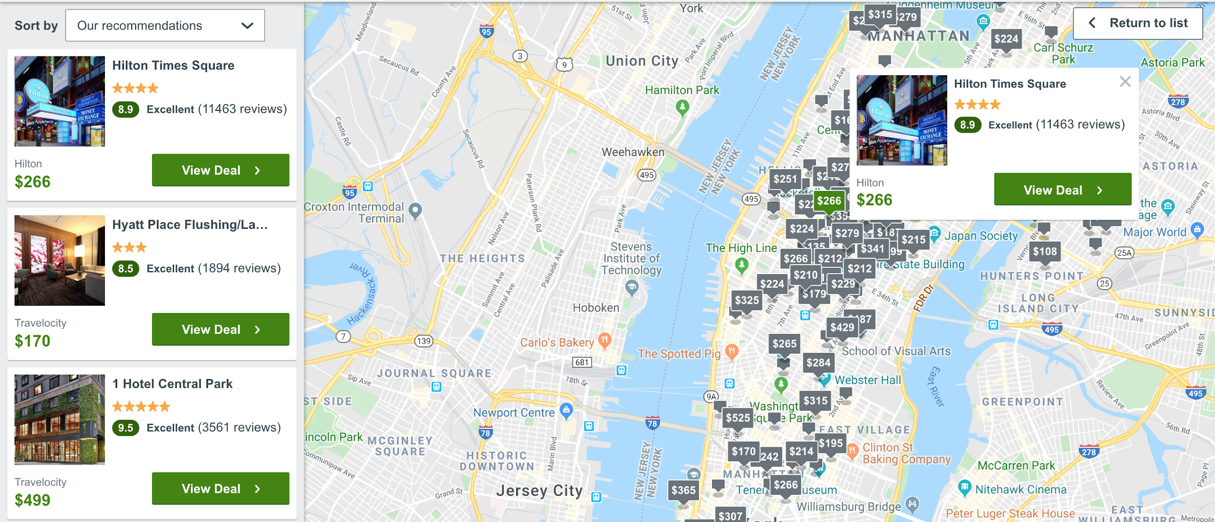
What was the problem?
The current trivago design is confusing and cluttered with a lot of functionality hidden to the user.
We want to improve the website to help the user have a simple, straightforward experience when finding hotels for their vacations.

Slide 4
User Requirements
User interface should reduce unused white space without adding unnecessary clutter.
Filter fields utilizing numerical values should have input boxes to improve user ability.
Menus should be easily readable and traversable.

Slide 5
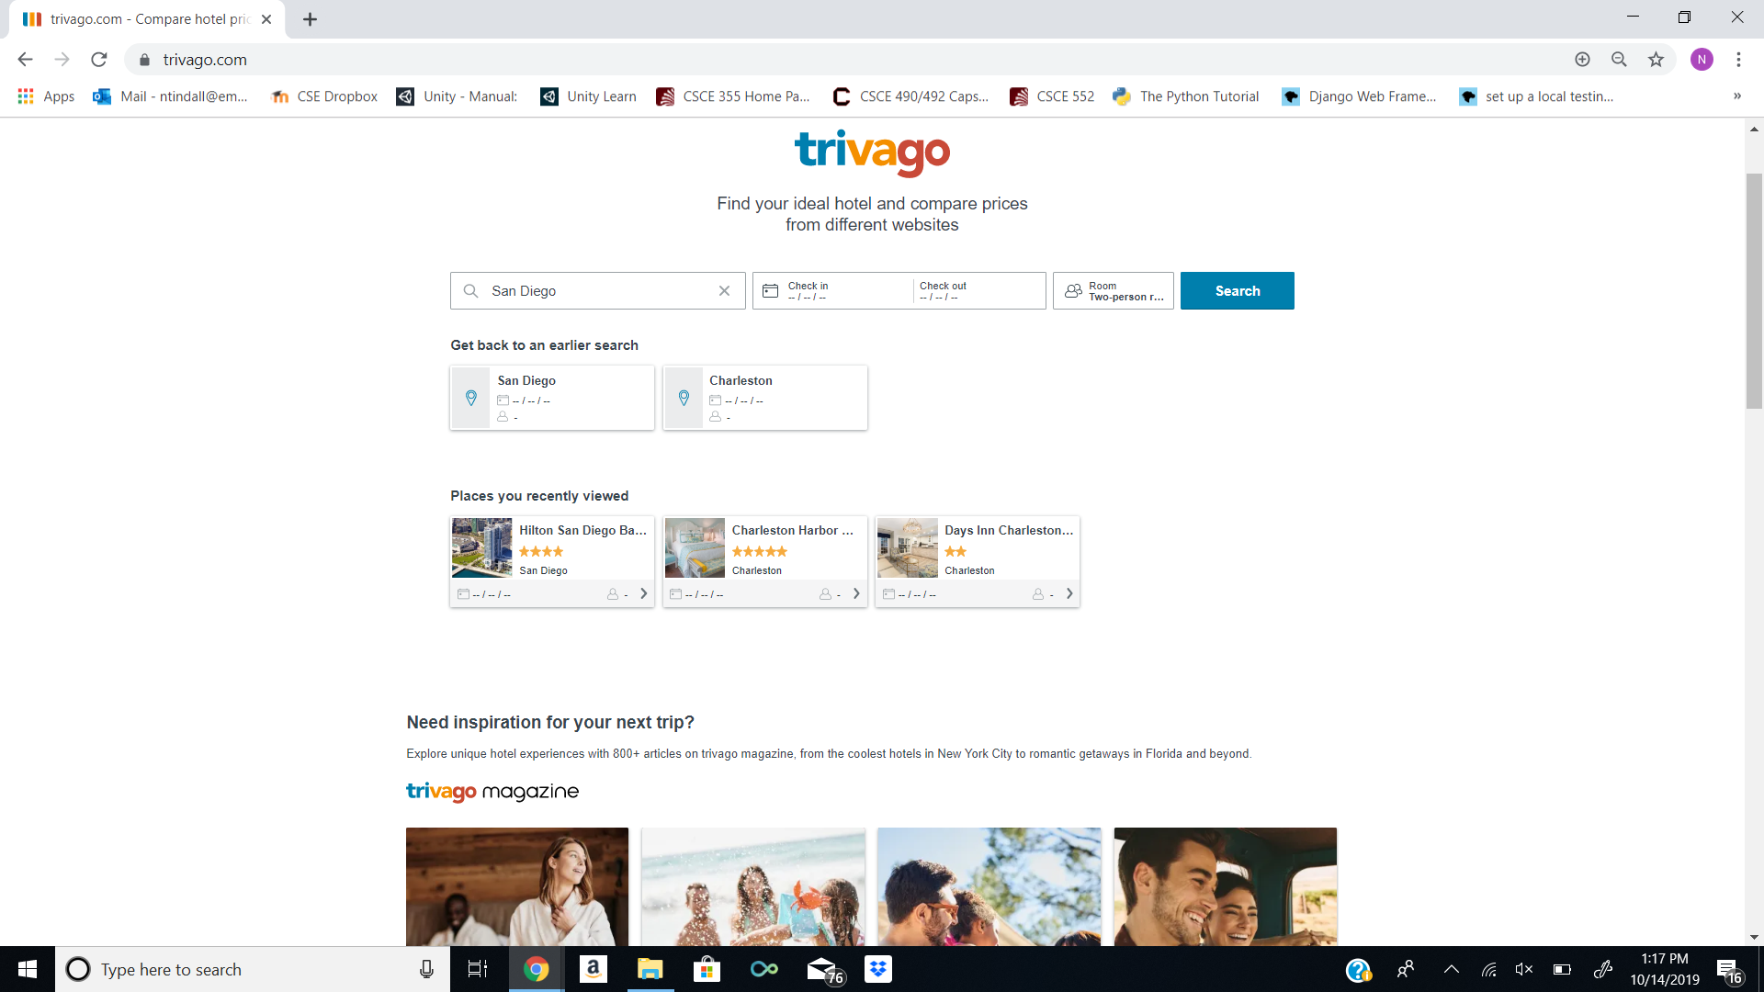
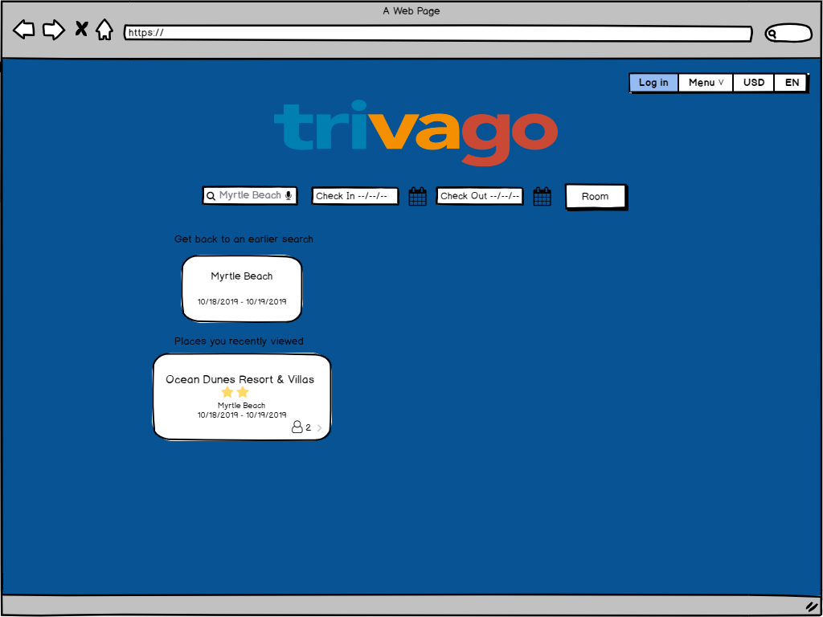
First Design: Homepage

Slide 6
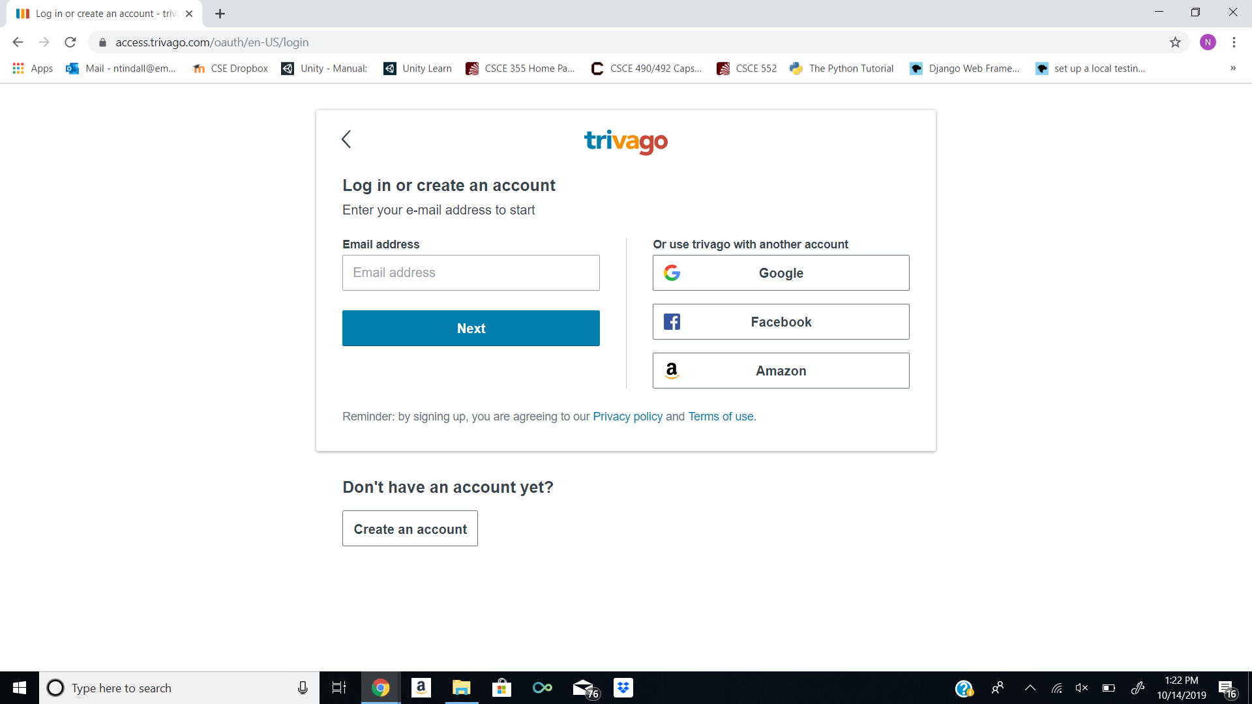
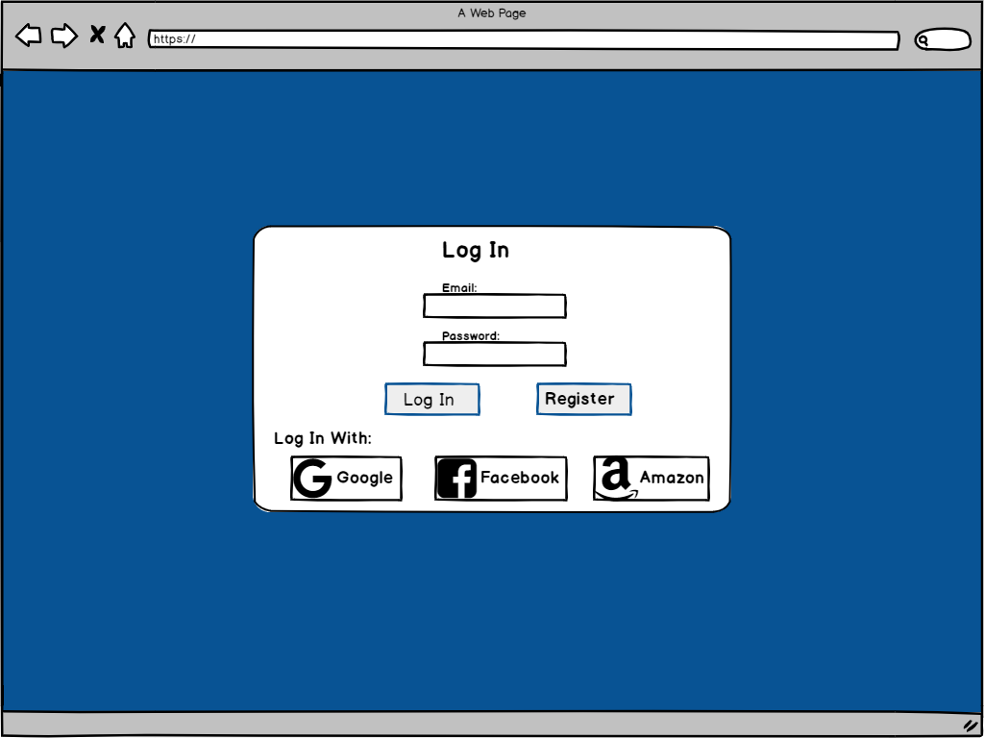
First Design: Log-In

Slide 7
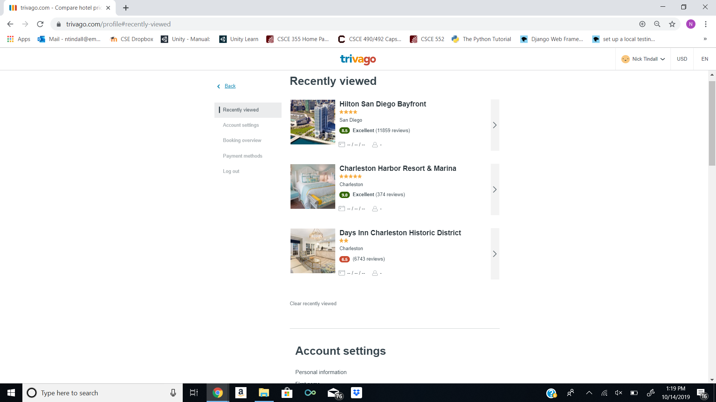
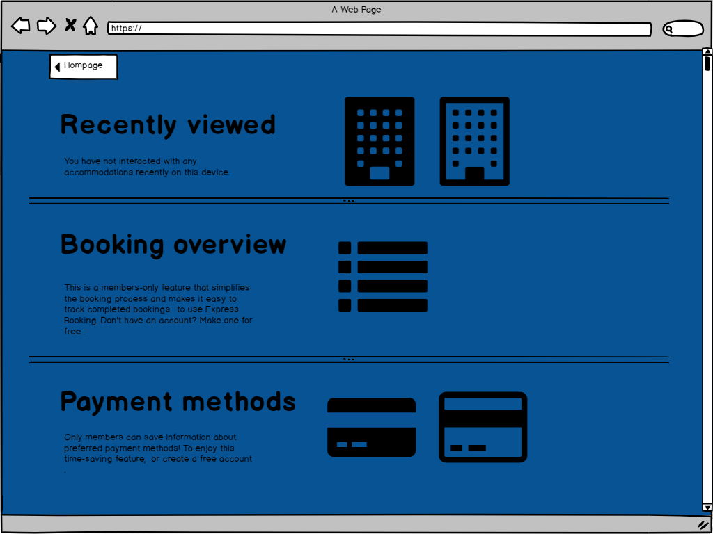
First Design: Menu Page

Slide 8
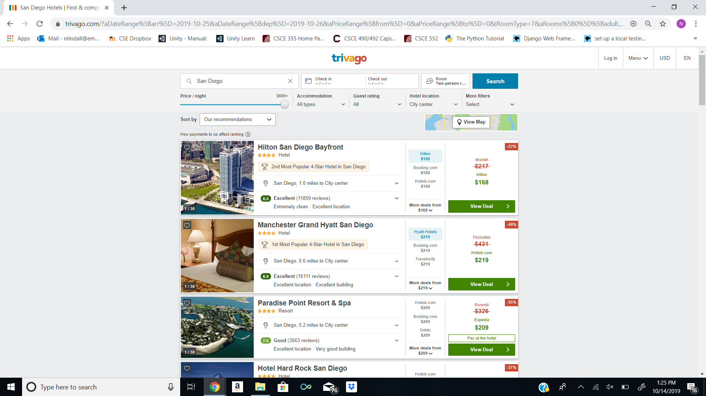
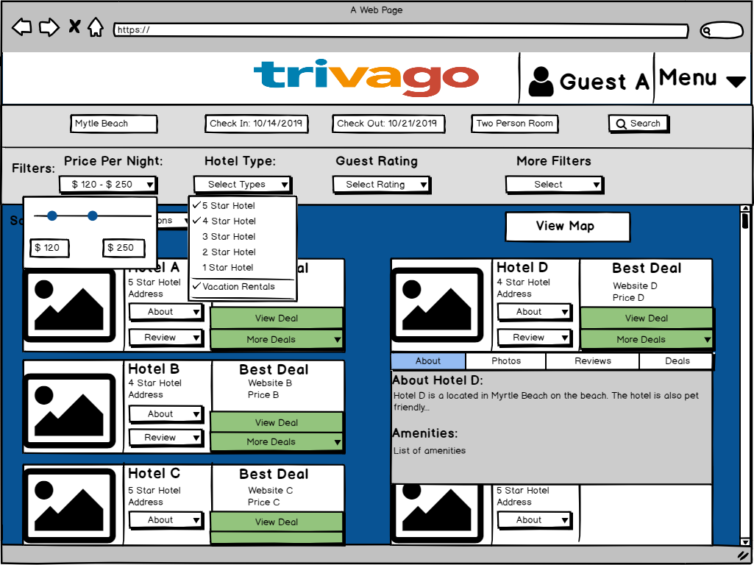
First Design: Search Page

Slide 9
User Testing and Evaluation methods used:
Card Sorting
To find the best way to organize all of the search filters of Trivago
Heuristic Evaluation
To test the functionality and layout of interface
Survey/Questionnaire
To better understand the user’s preferences when searching for a hotel

Slide 10
Card Sorting Result
Our card sorting method went well as we had 8 participants
Open Card Sort - cards consisted of attributes and amenities you would want in a potential hotel room and the user labels the groupings
The results varied for each participant.
Showed us what aspects are emphasized when searching for hotels
For Example, Rest and Relaxation was commonly chosen and shows the emphasis on comfort when picking the right hotel

Slide 11
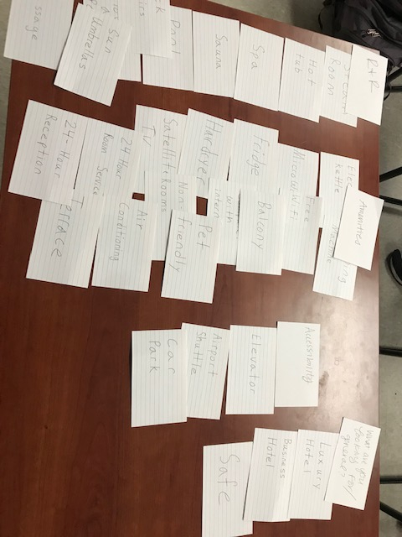
Card Sorting Example: Part 1

Slide 12
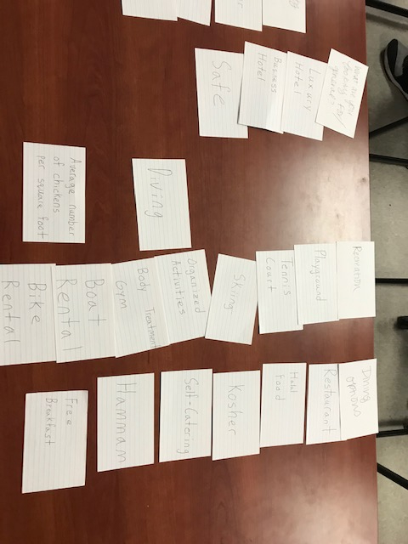
Card Sorting Example: Part 2

Slide 13
Heuristic Evaluation Result
Our heuristic evaluation had only 3 participants.
Heuristic Evaluations provide enough detail that 3 users give sufficient data
There were a lot of similar heuristics violated:
Bugs in functionality were detailed thoroughly
Color scheme
Search bar structure
Each evaluation had an impact on our final design

Slide 14
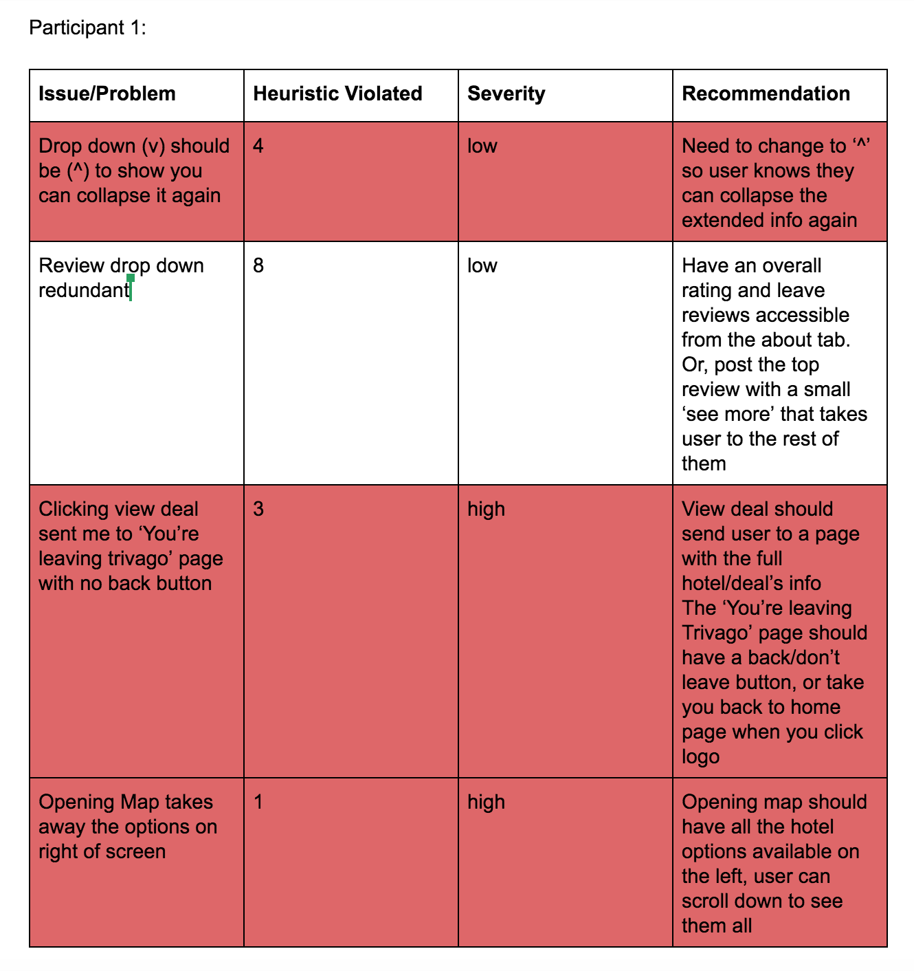
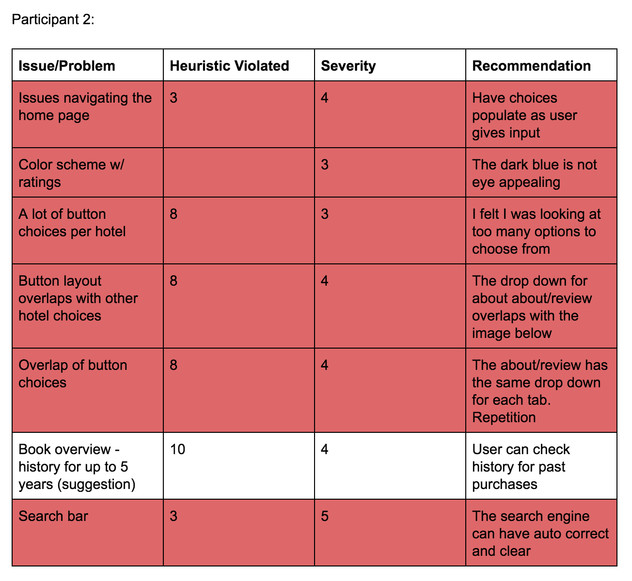
Heuristic Evaluation Example

Slide 15
Questionnaire Result
75% of respondents said they appreciated the simple and easy layout of trivago
Another 75% of respondents said they found issue with either color scheme or choice of font
Our open ended Questions gave us the most data; most answers emphasized the problem with the look of the website
Learning from Questionnaire
It was useful in identifying where changes are needed in the prototype
Most multiple choice results were answered as expected, no obvious issues
The outstanding issues were found only with aesthetics instead of functionality

Slide 16
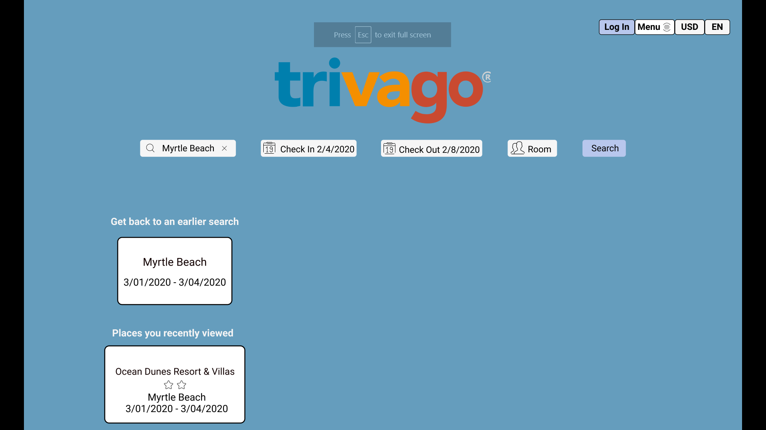
Second Design: Homepage

Slide 17
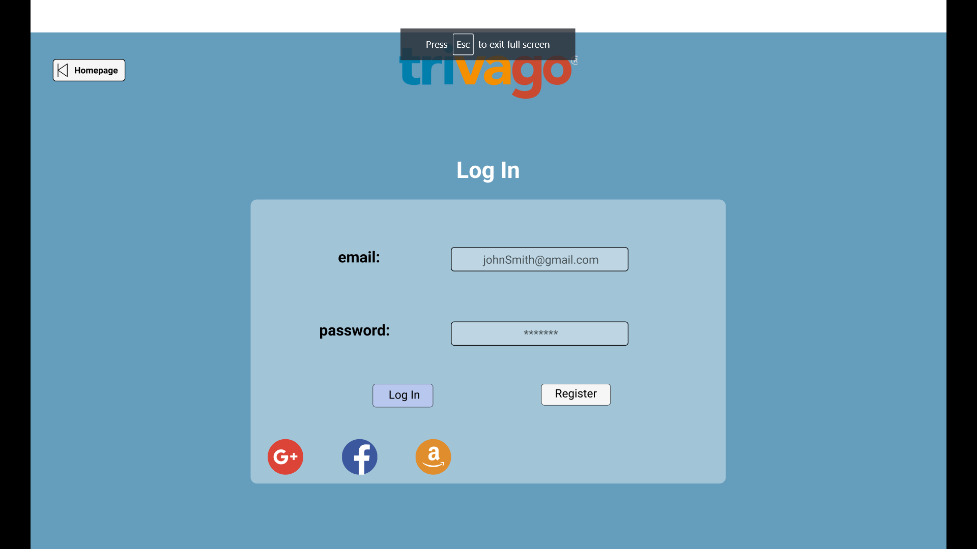
Second Design: Log-In

Slide 18
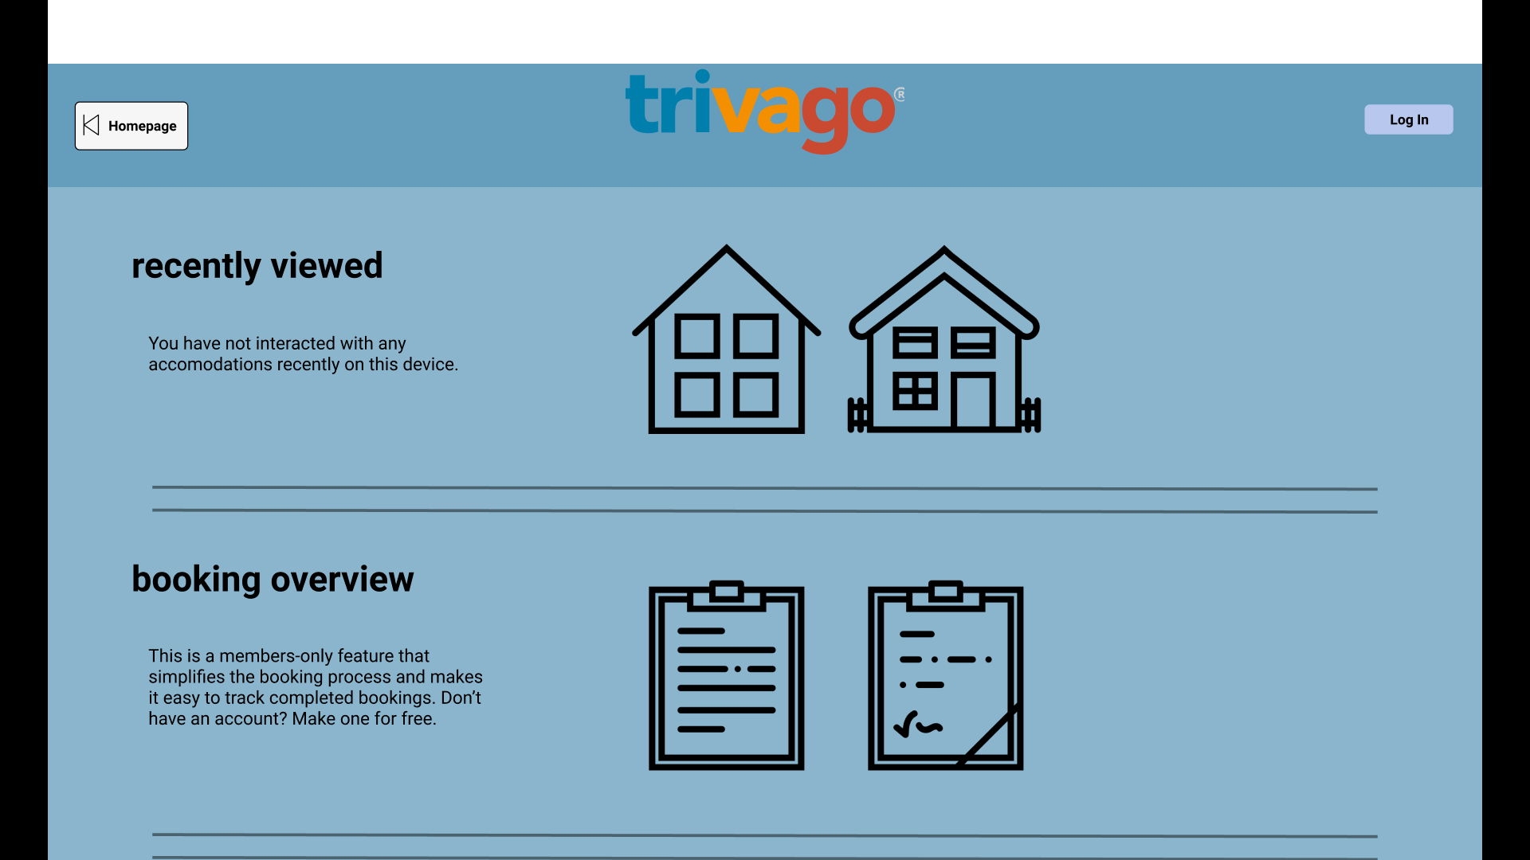
Second Design: Menu Page

Slide 19
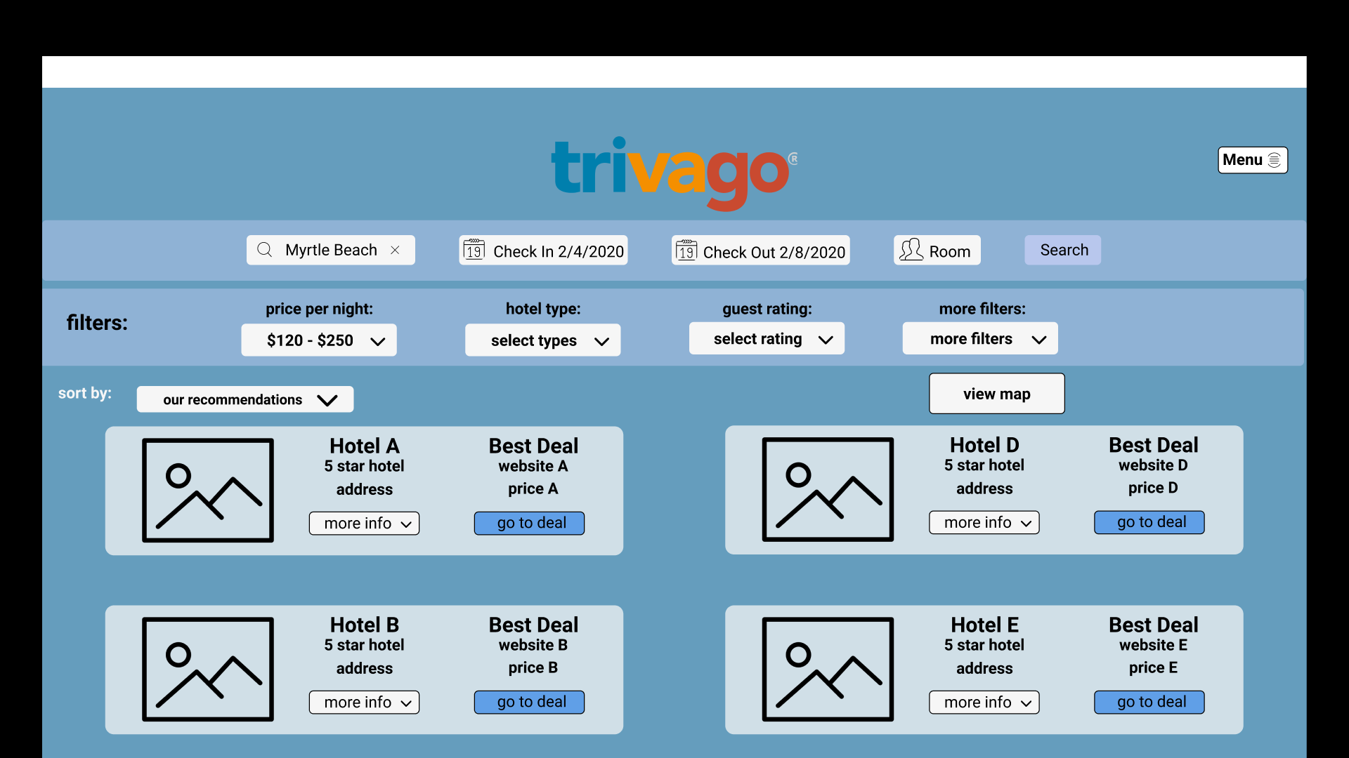
Second Design: Search Page

Slide 20
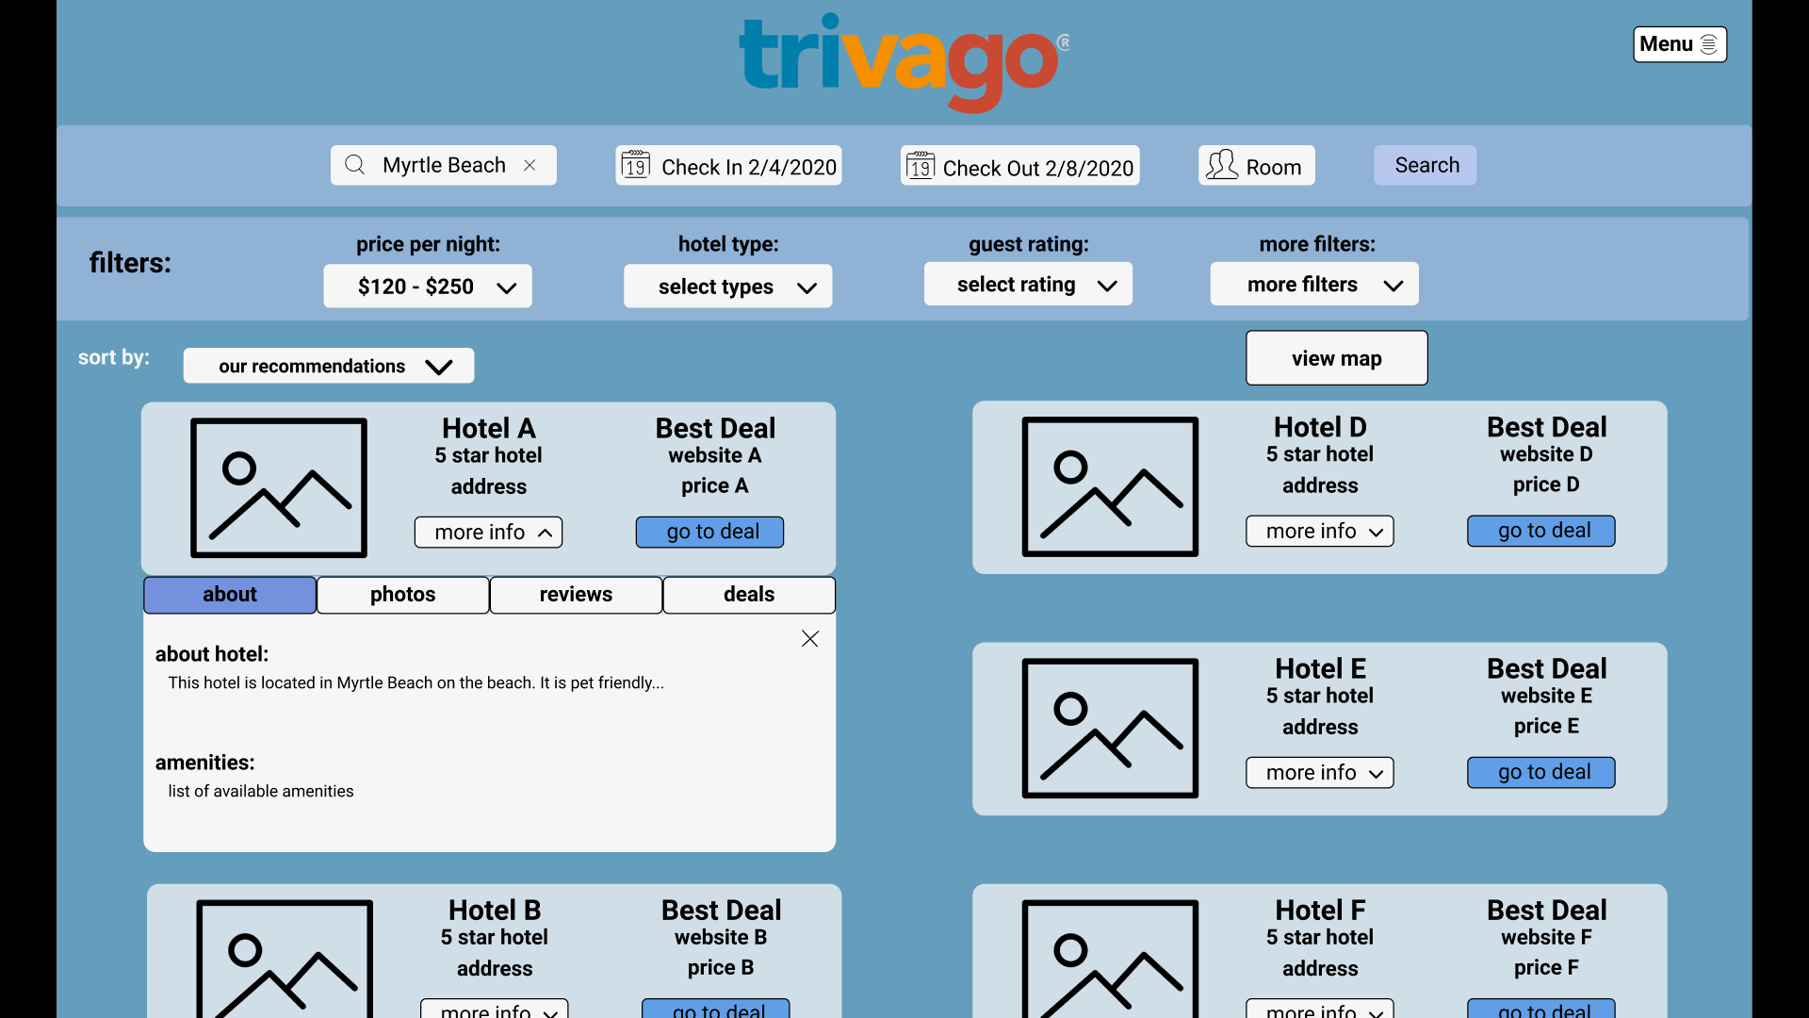
Second Design: Search Page with Hotel Info Card

Slide 21

Quick Demo

Slide 22
Questions?

